Slide 1

Pfizer Price Forecast
Predicting the future
of the market

Slide 2
Table of Contents
Hypothesis
Exploratory Analysis
Model Methodology
Results

Slide 3

Hypothesis
Using Pfizers stock data from previous years we should be able to predict future stock adjusted closing prices by using a time-series machine learning model

Slide 4
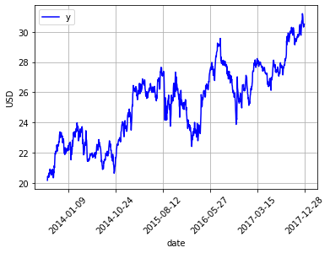
Exploratory Analysis

Slide 5
Exploratory analysis
 | Date | Open | High | Low | Close | Volume | Dividend | Split | Adj_Open | Adj_High | Adj_Low | Adj_Close | Adj_Volume
0 | 2017-12-28 | 36.360 | 36.53 | 36.25 | 36.37 | 6583100.0 | 0.0 | 1.0 | 30.492734 | 30.635301 | 30.400484 | 30.501120 | 6583100.0
1 | 2017-12-27 | 36.310 | 36.46 | 36.23 | 36.33 | 8319672.0 | 0.0 | 1.0 | 30.450802 | 30.576597 | 30.383711 | 30.467575 | 8319672.0
2 | 2017-12-26 | 36.090 | 36.27 | 35.95 | 36.21 | 10892371.0 | 0.0 | 1.0 | 30.266302 | 30.417257 | 30.148894 | 30.366938 | 10892371.0
3 | 2017-12-22 | 36.260 | 36.38 | 36.05 | 36.14 | 8598998.0 | 0.0 | 1.0 | 30.408870 | 30.509506 | 30.232757 | 30.308234 | 8598998.0
4 | 2017-12-21 | 36.585 | 36.60 | 36.19 | 36.24 | 14742620.0 | 0.0 | 1.0 | 30.681426 | 30.694006 | 30.350166 | 30.392097 | 14742620.0
https://www.quandl.com/data/EOD/PFE-Pfizer-Inc-PFE-Stock-Prices-Dividends-and-Splits
 | Open | High | Low | Close | Volume | Dividend | Split | Adj_Open | Adj_High | Adj_Low | Adj_Close | Adj_Volume
count | 1090.000000 | 1090.000000 | 1090.000000 | 1090.000000 | 1.090000e+03 | 1090.000000 | 1090.0 | 1090.000000 | 1090.000000 | 1090.000000 | 1090.000000 | 1.090000e+03
mean | 32.525915 | 32.762496 | 32.283939 | 32.526532 | 2.633704e+07 | 0.004477 | 1.0 | 25.293804 | 25.477134 | 25.106294 | 25.294480 | 2.633704e+07
std | 2.147734 | 2.150970 | 2.161098 | 2.159424 | 1.472893e+07 | 0.035718 | 0.0 | 2.516028 | 2.520140 | 2.520443 | 2.524062 | 1.472893e+07
min | 27.810000 | 27.970000 | 27.510000 | 27.700000 | 6.397307e+06 | 0.000000 | 1.0 | 20.318957 | 20.441490 | 20.081097 | 20.189215 | 6.397307e+06
25% | 30.780000 | 31.032500 | 30.520000 | 30.712500 | 1.836838e+07 | 0.000000 | 1.0 | 23.078464 | 23.261962 | 22.898993 | 23.053374 | 1.836838e+07
50% | 32.660000 | 32.900000 | 32.380000 | 32.650000 | 2.363718e+07 | 0.000000 | 1.0 | 25.779051 | 25.935757 | 25.525171 | 25.757361 | 2.363718e+07
75% | 34.167500 | 34.430000 | 33.980000 | 34.187500 | 3.056132e+07 | 0.000000 | 1.0 | 27.206844 | 27.381910 | 27.027917 | 27.262360 | 3.056132e+07
max | 37.170000 | 37.390000 | 37.060000 | 37.310000 | 2.844623e+08 | 0.320000 | 1.0 | 31.172027 | 31.322981 | 31.079777 | 31.197186 | 2.844623e+08

Slide 6
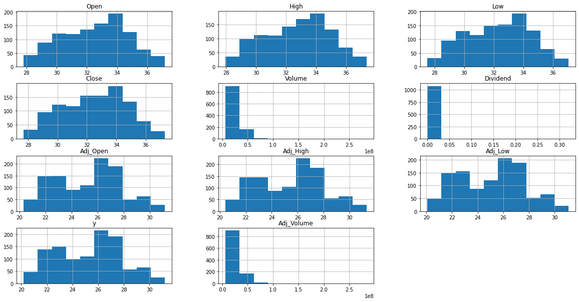
Exploratory Analysis

Slide 7
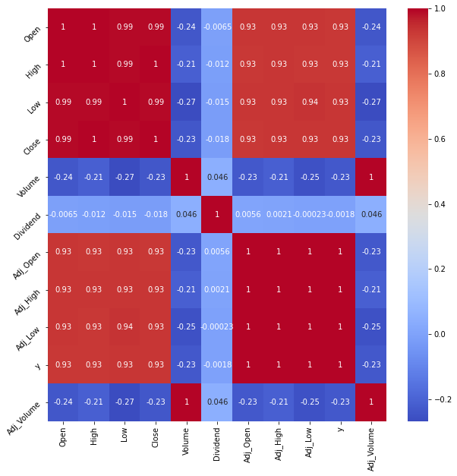
Exploratory Analysis

Slide 8

Model Methodology

Slide 9
Results
 | horizon | mse | rmse | mae | mape | mdape | coverage
0 | 4 days | 0.384799 | 0.620322 | 0.594585 | 0.020539 | 0.022642 | 0.416667
1 | 5 days | 0.442134 | 0.664932 | 0.579477 | 0.020118 | 0.017811 | 0.333333
2 | 6 days | 0.598291 | 0.773493 | 0.657682 | 0.022927 | 0.028477 | 0.333333
3 | 7 days | 0.904540 | 0.951073 | 0.846359 | 0.029491 | 0.035610 | 0.333333
4 | 8 days | 0.949004 | 0.974168 | 0.877699 | 0.030516 | 0.025427 | 0.333333
5 | 11 days | 1.009708 | 1.004842 | 0.863197 | 0.030114 | 0.038724 | 0.333333
6 | 12 days | 1.817441 | 1.348125 | 1.119182 | 0.039382 | 0.046744 | 0.333333
7 | 13 days | 3.049666 | 1.746329 | 1.524936 | 0.053906 | 0.058429 | 0.333333
8 | 14 days | 3.799241 | 1.949164 | 1.766079 | 0.062490 | 0.045805 | 0.083333
9 | 15 days | 3.888734 | 1.971987 | 1.794315 | 0.062875 | 0.047826 | 0.000000
10 | 18 days | 4.972411 | 2.229890 | 2.087646 | 0.073899 | 0.078335 | 0.000000
11 | 19 days | 4.922843 | 2.218748 | 2.091317 | 0.074312 | 0.068431 | 0.000000
12 | 20 days | 4.678097 | 2.162891 | 2.025777 | 0.071809 | 0.058134 | 0.000000
13 | 21 days | 4.605464 | 2.146035 | 2.016247 | 0.071380 | 0.056406 | 0.000000

Slide 10
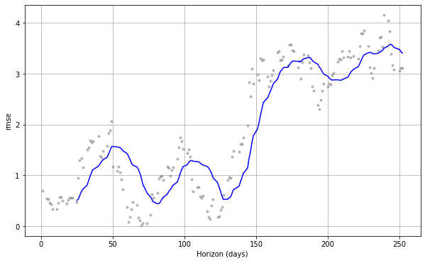
Results

Slide 11
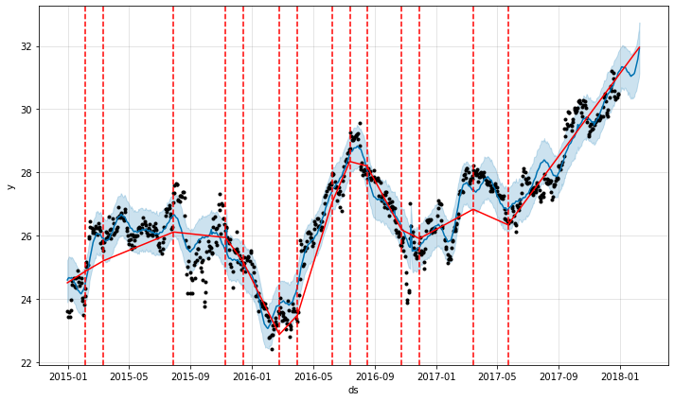
Results

